Slide 1
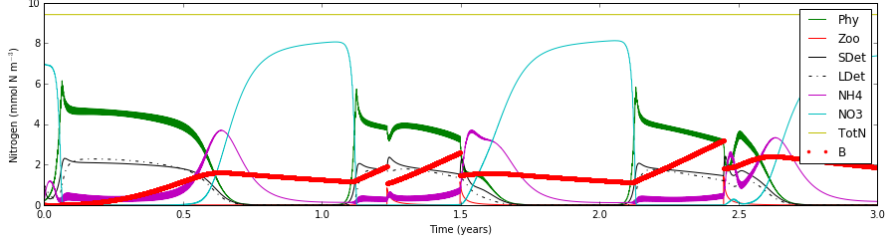

Slide 2
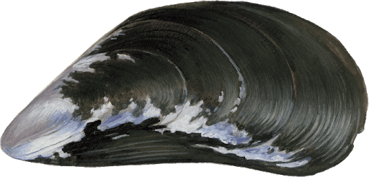

Slide 3



1 m
1 m
1 m

Slide 4
1 m
1 m
1 m

